Slide 1
INNOVATION LAB PROJECT
Dynamic Author Name Disambiguation for Growing Digital Libraries
Name : Harsh Bharadwaj
Roll No : 1901cs23
Mentor : Dr. Joydeep Chandra

Slide 2
Description of The Project
When a digital library user searches for publications by an author name, they often see a mixture of publications by different authors who have the same name.
The aim is to design an algorithm which can segregate(disambiguate) research publications bearing same names on the basis of the available metadata with the research papers.
The metadata considered for comparison in the following algorithm are :
Co-author List
Title of the Paper
Keywords
Paper Abstract
Venue of Publication

Slide 3
Description of The Algorithm
The Algorithm can be broken down into two parts , BATCH-AD and INCREMENTAL-AD.
In the BATCH-AD part , we run the algorithm on all the available papers and group them into clusters , where each cluster represents an individual author and contains all his research publications.

Slide 4
Description of The Algorithm
The INC-AD part assigns publications to clusters(or create a new cluster containing this single paper) as they arrive(uploaded to the digital library).
This is achieved by creating an Author Profile for each cluster obtained from the Batch-Ad part and using it to identify if the paper belongs to a specific cluster or not.

Slide 5
Motivation For a Two step Algorithm
The digital libraries are growing at a very fast pace and thousands of papers are added every week .
Repeating the pair-wise comparison method for the clusterisation process over and over can consume a lot of time , and thus we need an online algorithm for assigning publications to the respective authors.

Slide 6
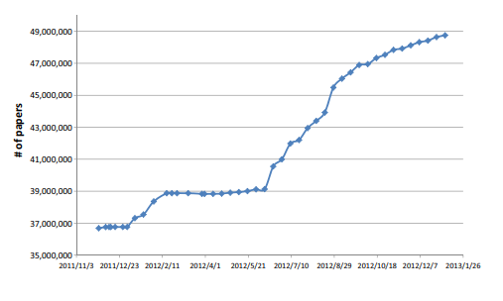
The Data Growth of Microsoft Academic Search

Slide 7
BATCH-AD Description
Similarity score between two records(that carry a common name) is calculated by calculating similarities between the available features of the paper.
We represent each metadata as a vector of items. For coauthor name , each vector item is a coauthor name . For obtaining the vectors for Paper title and Paper abstract, word bigrams are generated from the original text after removing stop words.
For accuracy consideration, we further weight the aforementioned metadata items by what we call IPF (Inverse Paper Frequency).

Slide 8


BATCH-AD Description
IPF value for an item of a metadata is calculated using the following formula:
a_{hi} = item in a particular feature
f(a_{hi}) = frequency of a_{hi} in all paper set.
N_{h} = maximum f(a_{hi}) for a specific feature.
Every feature is represented as a weighted vector :

Slide 9


Batch-AD Description
Similarity score for a feature is calculated using the following formula :
From the obtained similarities we create a similarity profile vector for any pair of records ri , rj :
X(ri , rj) = (S1 , S2 , S3 , S4 , S5 , S6)
We calculate the Similarity score S using the following formula:
Where vector w is the vector of weights and b is the threshold obtained by Minimizing the Loss function using Hyper-Opt.
S>0 suggests that both records belong to the same author , otherwise they don’t.

Slide 10
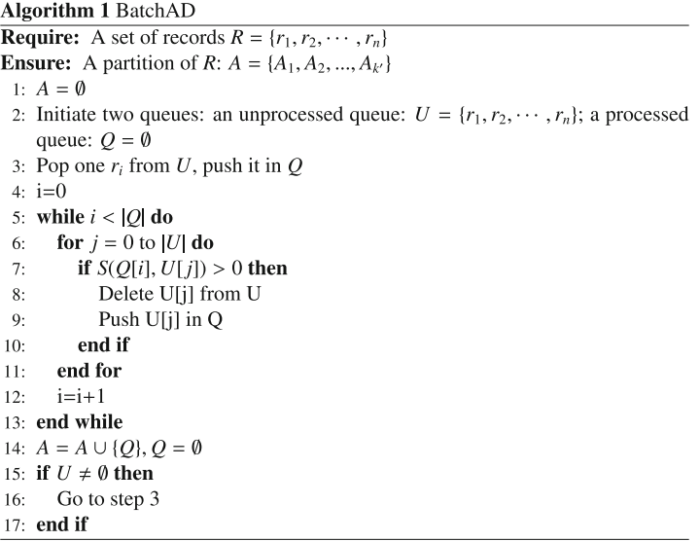
BATCH-AD Pseudo Code

Slide 11
Hyper-Opt(Model Used for minimizing the loss function)
The function we wanted to minimize is simply the value 1 - pf1 , where pf1 is the pair wise f1 score of the clusterization obtained using a specific set of weights and b.
Hyper-Opt is a python library using a form of Bayesian optimization and can be used for minimization problems.

Slide 12
Incremental-AD Description
In this part , we want to solve the following problem first : given r_{new} and a record cluster A_{i} , decide whether r_{new} should be assigned to A_{i.}
Each cluster corresponds to an author , so we create an author profile for each cluster , on what topics the author is more likely to write , with whom he’s more likely to co-author a paper etc...

Slide 13

Incremental-AD Description
Here, we note A_{i} author model as M(A_{i}). We propose to build five metadata model M₁(A₁) , M₂(A₂) … M₅(A₅) for each metadata to represent the author model M(A_{i}).
To build M_{h}(A_{i}), we try to estimate A_{i}’s probability distribution over the items of metadata F_{h}. First, we list all occurrence of items of F_{h} to form a metadata vocabulary V_{h} for each metadata. In addition, we add one more item into V_{h} to represent the items unseen so far. Then, we estimate Ai’s probability distribution over V_{h}. Specifically, the task is to estimate the probability that A_{i} has item a_{hi} , so that:

Slide 14
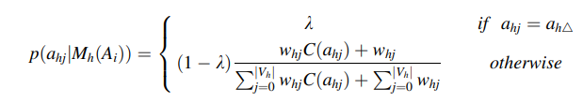
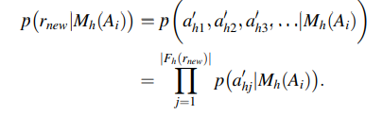
Incremental-AD Description
In this equation, C(a_{hj}) is the occurrence count of a_{hj} in all records of Ai, and w_{hj} is the IPF weight.
The probability that M_{h}(A_{i}) produces r_{new} can be computed as:

Slide 15


Incremental-AD Description
Now we aggregate each metadata model’s prediction result to decide whether r_{new} should be assigned to A_{i} .
The function F is trained on labelled data using HyperOpt.
A(r_{new}) is the set of clusters for which I(r_{new} ,A_{i}) >0 .

Slide 16
Incremental-AD Description
If no similar clusters are identified , A new cluster is created(Addition of a new author) and this single paper is assigned to the cluster.
If one similar cluster is identified , the paper is simply added to the cluster and it’s author profile is updated.
If more than one clusters are identified , all clusters are merged into a new on and the paper is added to the new cluster and it’s assigned a new author profile.

Slide 17
Performance of the Algorithm
The algorithm was trained and tested on the dataset obtained from DBLP(around 3000 records).
The results were as follows :

Slide 18
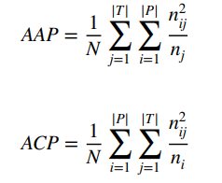
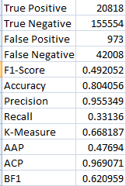

BATCH-AD Only

Slide 19
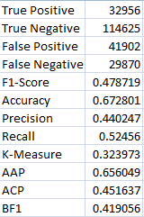
BATCH-AD + INC-AD

Slide 20
Link to the Dataset , Code and referred Paper
https://github.com/pac-man21/Dynamic-Author-Disambiguation

Slide 21
THANK YOU

